Slide 1
2,8“ NEU

Slide 2











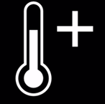




WLAN-Thermometer
WLAN-Thermometer
WLAN-Thermometer
WLAN-Thermometer
WLAN-Thermometer
WLAN-Thermometer
PWM
PWM
PWM
PWM

Slide 3
















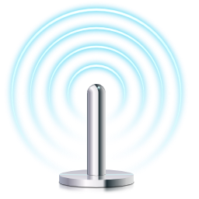
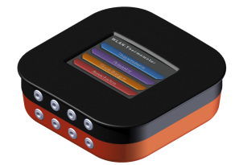







WLAN-Thermometer
PID
1
2
3
4
5
6
7
8
9
0
←
-
Enter
WLAN-Thermometer
WLAN-Thermometer
WLAN-Thermometer
WLAN-Thermometer
WLAN-Thermometer
PID
Z
Z
Z

Slide 4



